Slide 1
Big Mountain Resort
Data-Driven business strategy development

Slide 2
Problem Statement
Big Mountain Resort wants to develop pricing and operational business strategy as soon as possible to maximize capitalization on its facilities to address the $1.54M increase in operational costs after installing new chair lift this season.

Slide 3
Context
Recently, Big Mountain Resort has enhanced visitor distribution across its expanse by installing a new chair lift, that escalated the operational costs by $1.54 million this season. The management now requires insights on which facilities will deliver a better return on investment. Additionally, they are seeking strategic data-driven guidance on any potential adjustments to ticket prices, offerings and operation of the resort’s facilities, to stay competitive in the market.

Slide 4
Criteria of Success
An understanding is achieved regarding which facilities provide the most return on investment, identifying the areas of potential growth to further enhance revenue generation.
Effective pricing strategy and operational changes are developed, optimizing revenue while providing visitor satisfaction and competitiveness in the market.
Break-even point and profit margins are achieved to offset the increased operational costs by $1.54M as soon as possible.

Slide 5
Key Findings
Features that are the most impactful on the resort’s ticket price:
Total number of chairs and fast quads
Number of runs
Area covered by snowmaking machines
Vertical Drop

Slide 6


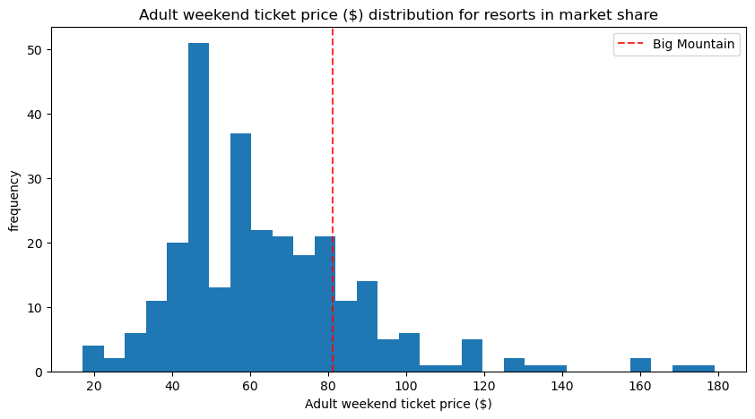
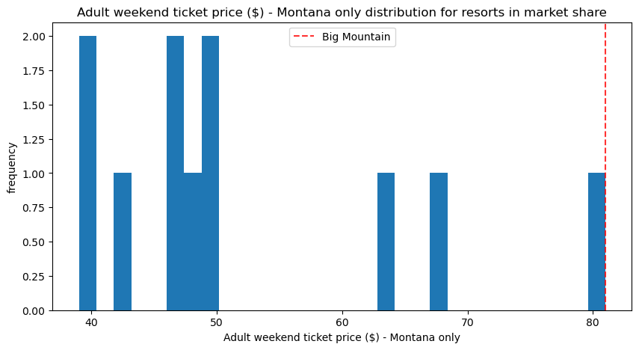
Big mountain’s ticket price
… is at the upper half of the overall prices among all states
… is the highest among all other resorts in the state of Montana

Slide 7
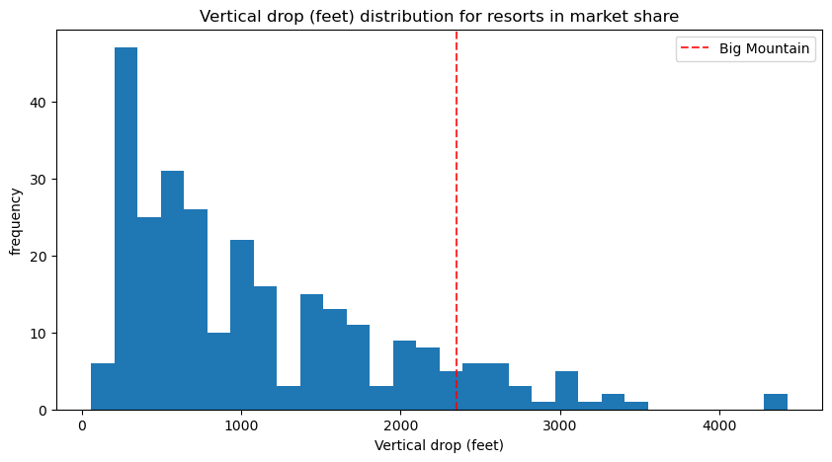
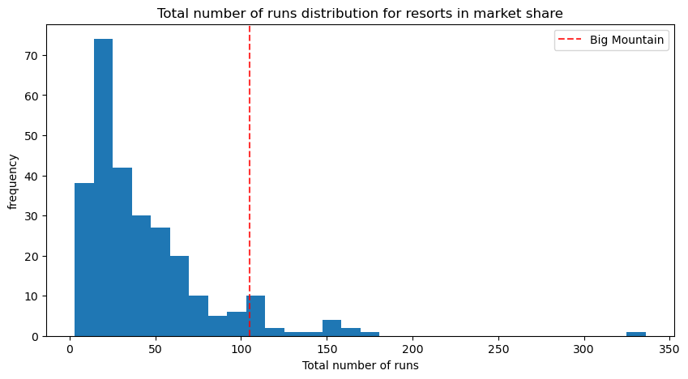
Vertical drop and runs overview
Vertical drop
Number of runs

Slide 8
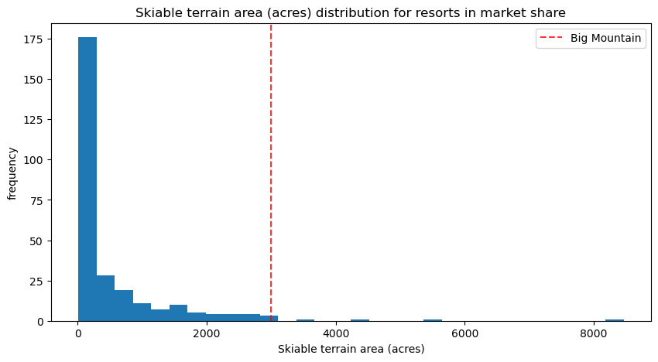
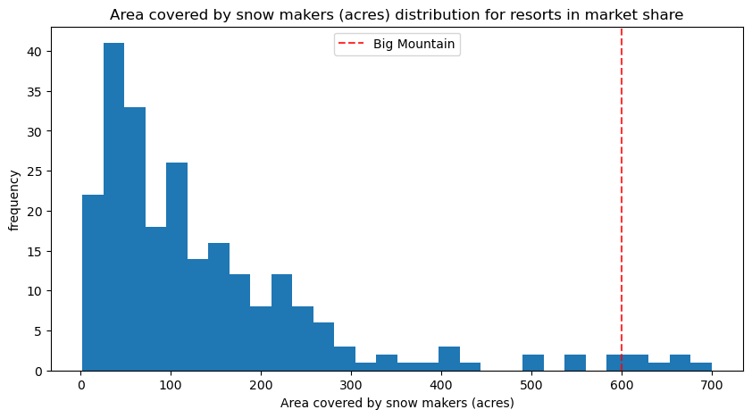
Skiable and snowmaking area overview
Skiable area
Snowmaking area

Slide 9
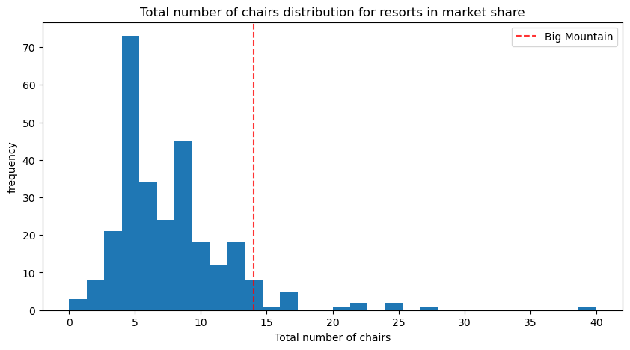
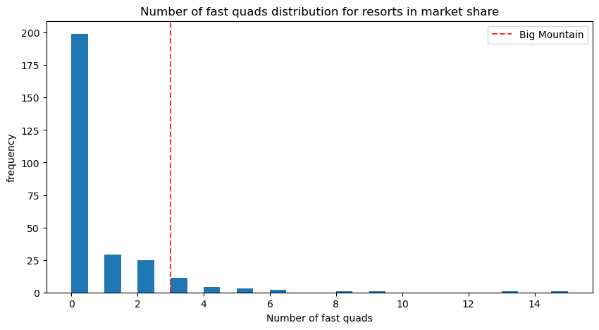
Number of chairs and fast quads overview
Number of chairs
Number of fast quads

Slide 10
Modeled price
Actual ticket price: $81.00
Modeled ticket price: $85.48 – $106.26 ($95.87 ± $10.39)
Questions:
Are we underpricing?
Are there any other factors that we should account for?

Slide 11
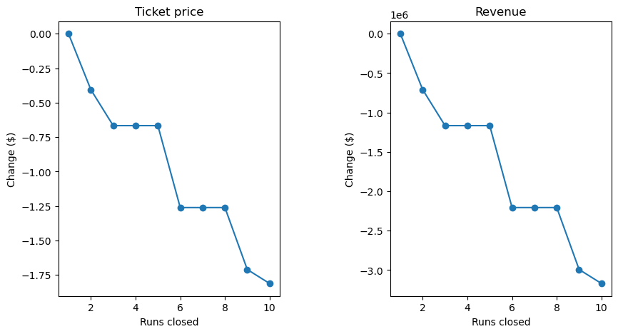
Scenario 1 - Permanently closing to 10 of the least used runs
Closing 1 makes no difference
Closing 2-3 reduces support for ticket price and revenue
Closing 4-5 has no effect compared to closing 3
Closing 6 or more leads to a huge drop

Slide 12
Scenario 2 vs. Scenario 3
Scenario 2 - Increase the vertical drop by adding a run to a point 150 feet lower down but requiring the installation of an additional chair lift to bring skiers back up, without additional snow making coverage.
Scenario 3 - Same as Scenario 2 but adding 2 acres of snow making cover.
- No change compared to Scenario 2 but increases operational costs!
Increases support for ticket price by $1.99
Increases seasonal revenue by $3474,638

Slide 13
Scenario 4 - Increase the longest run by 0.2 mile to boast 3.5 miles length, requiring an additional snow making coverage of 4 acres
No difference to the ticket pricing or the revenue demonstrated.

Slide 14
Recommendations and conclusion
Scenario 2 might be the most optimal business strategy proposed
Ticket price can be safely increased by $1.99 to a value of $82.99 with this change. Further increase may be considered with more data and intel.
This will increase total resort’s seasonal revenue by $3,474,638, which can help to cover new operational costs.
We might need to revisit this issue if the new data with operational and installation costs will be available.

